Slide 1


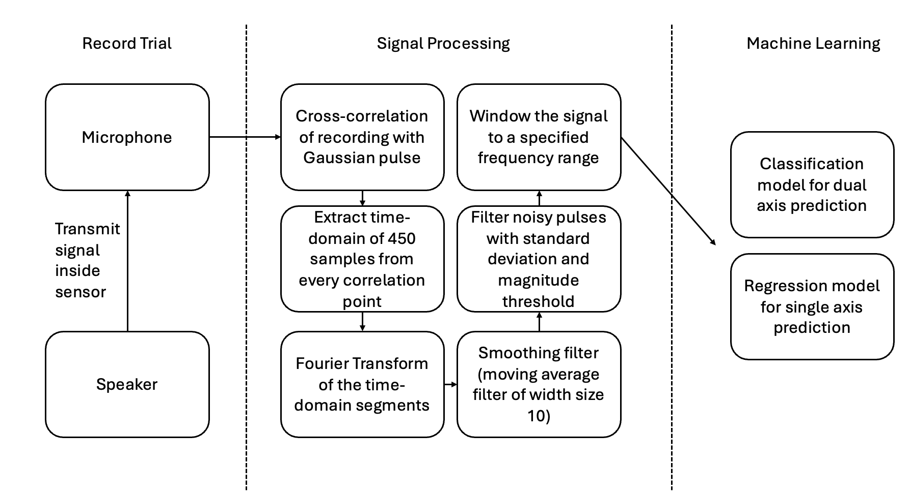
Signal generation
Controller
Buffer
Fast Fourier Transform
Frequency selection
Smooth signal
Classification
Load model
Transmit prediction
Consecutive key check
Simulate keypress
Regression
Signal processing
Machine learning
Socket server

